Slide 2
Entity Framework Core Internals
Phong Nguyen

Slide 3
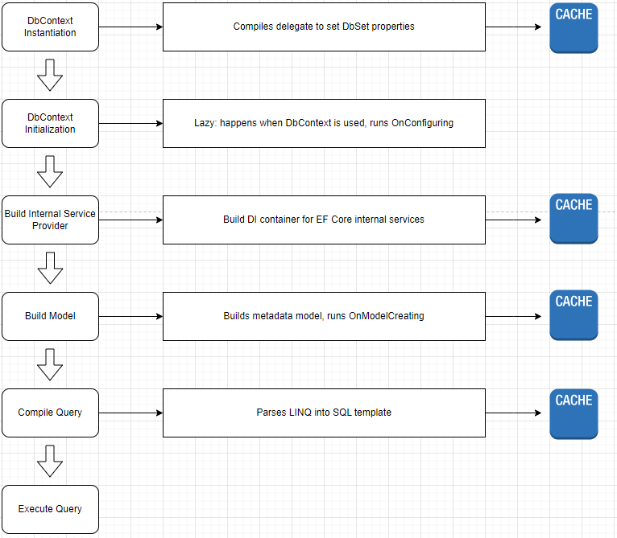
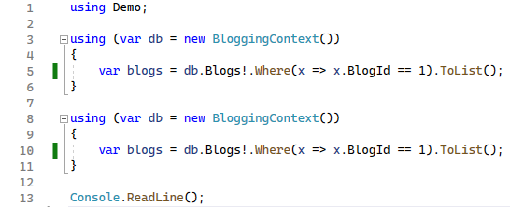
High-Level Overview

Slide 4
DbContext Instantiation and Initialization

Slide 5
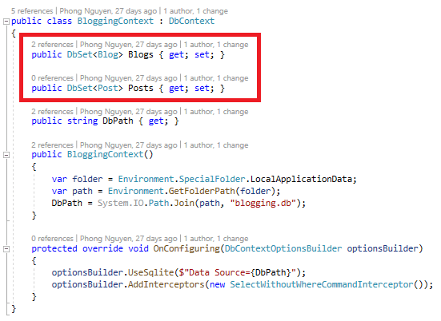
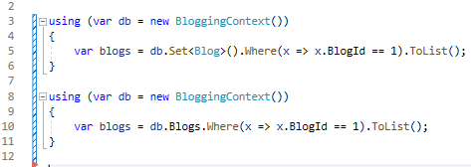
Query Root

Slide 6
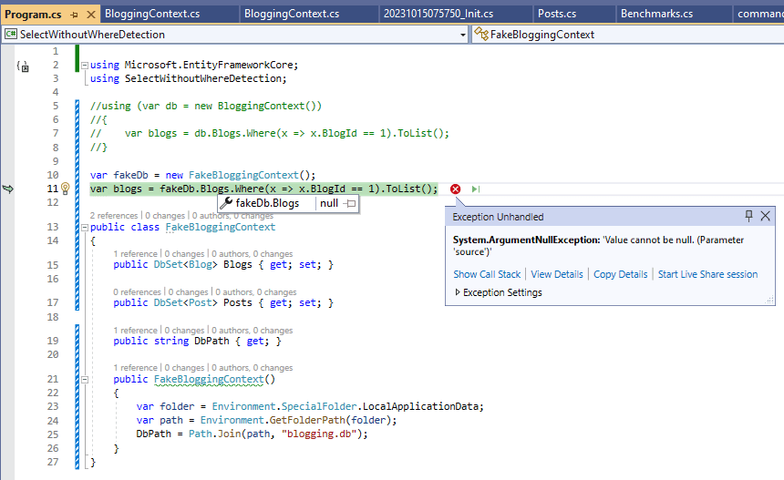
NullReferenceException

Slide 7
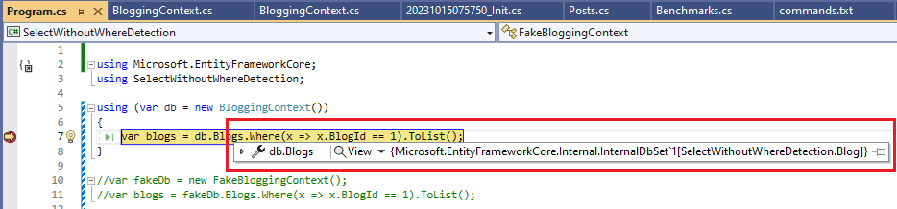
DbContext Instantiation

Slide 8
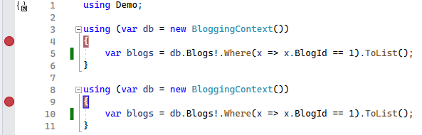
DbContext Initialization

Slide 9
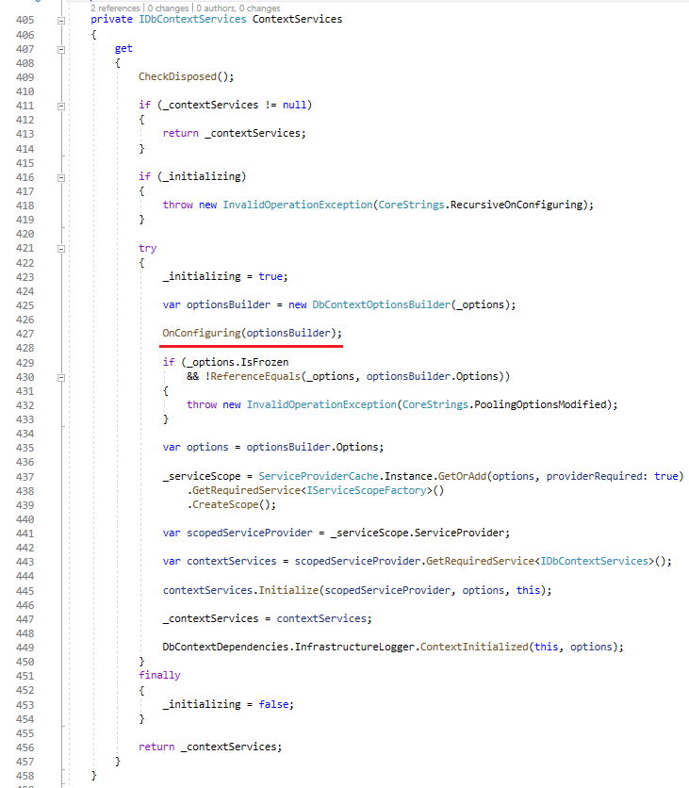
DbContext Initialization

Slide 10
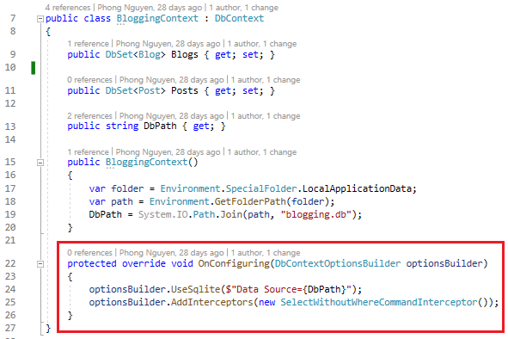
DbContext Initialization

Slide 11
Internal Service Provider

Slide 12
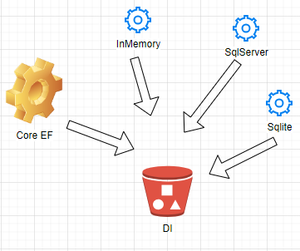
Internal Service Provider

Slide 13
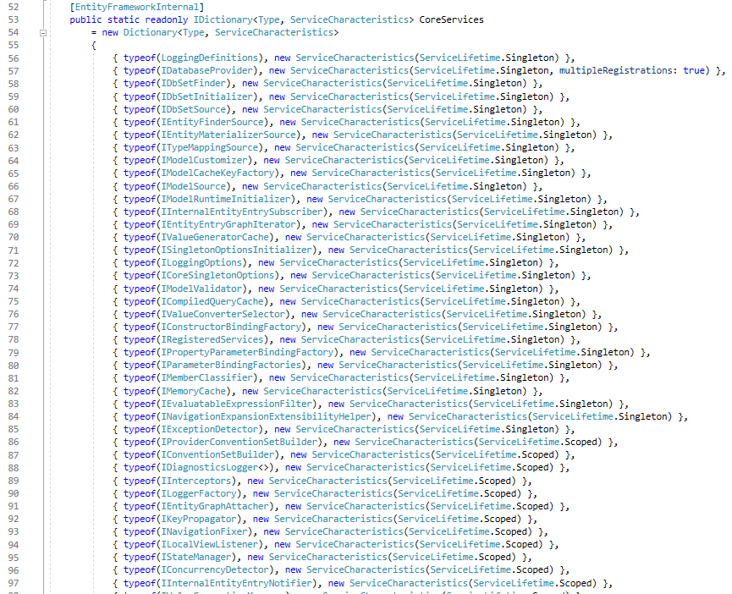
Core Services

Slide 14
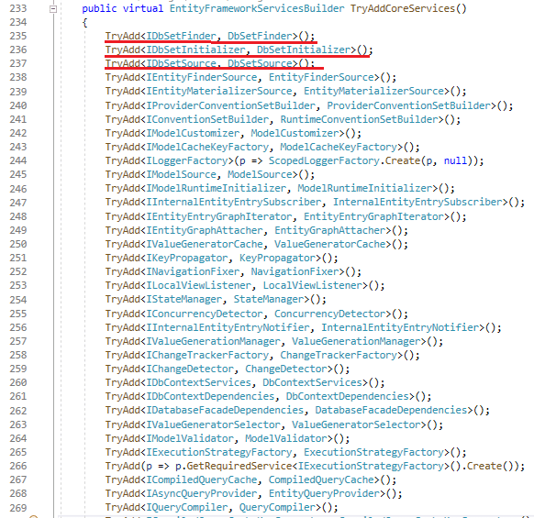
Core Services

Slide 15
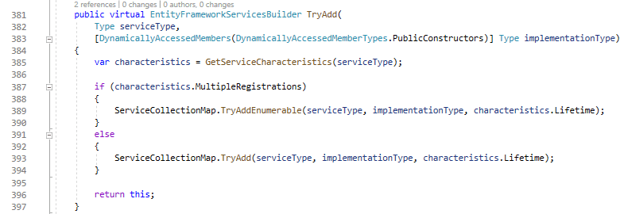
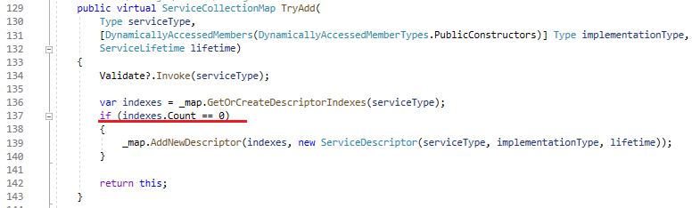
TryAdd Method

Slide 16
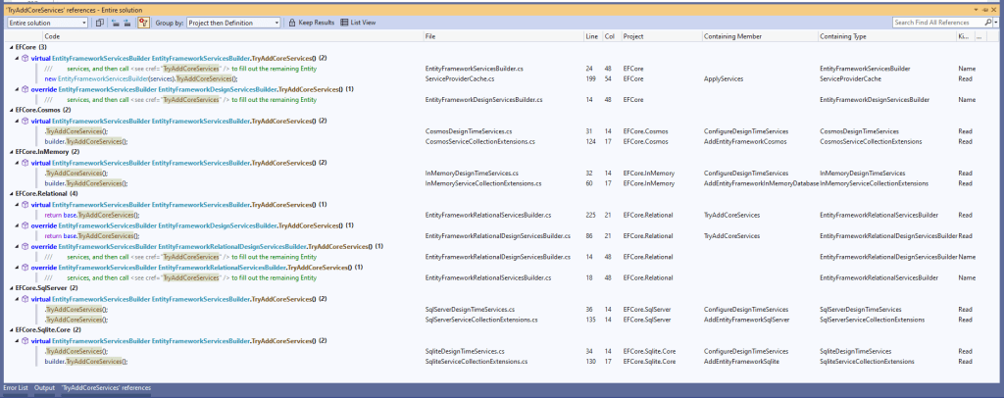
Database Specific Services

Slide 17
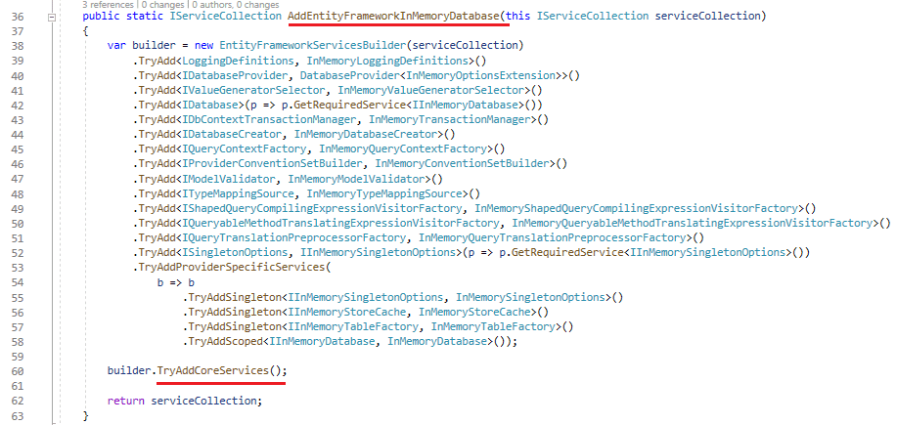
InMemoryDatabase Services

Slide 18
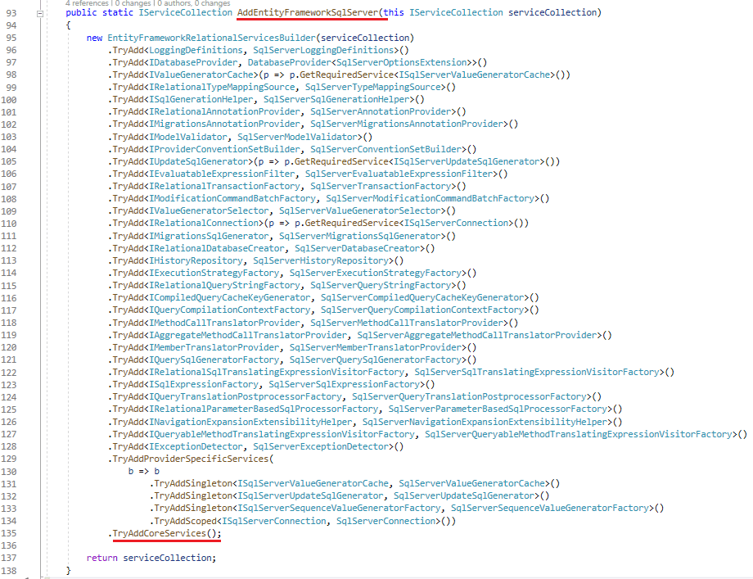
SqlServer Services

Slide 19
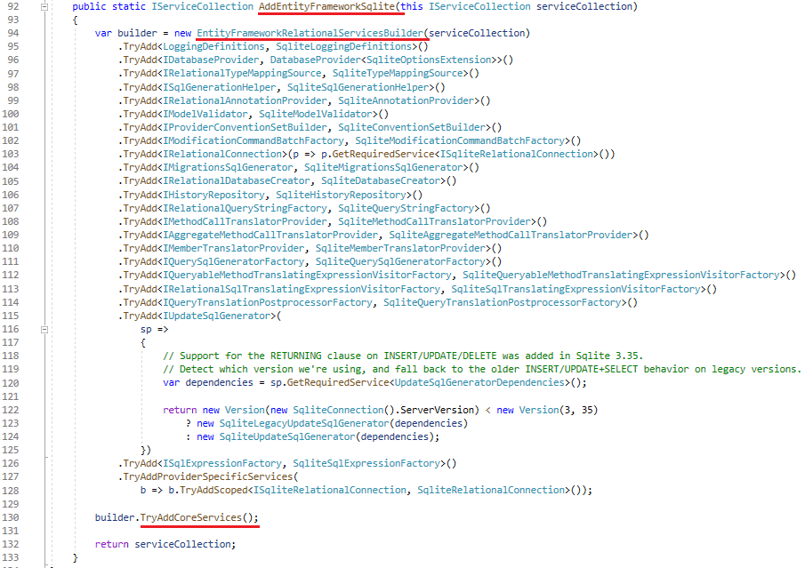
Sqlite Services

Slide 20
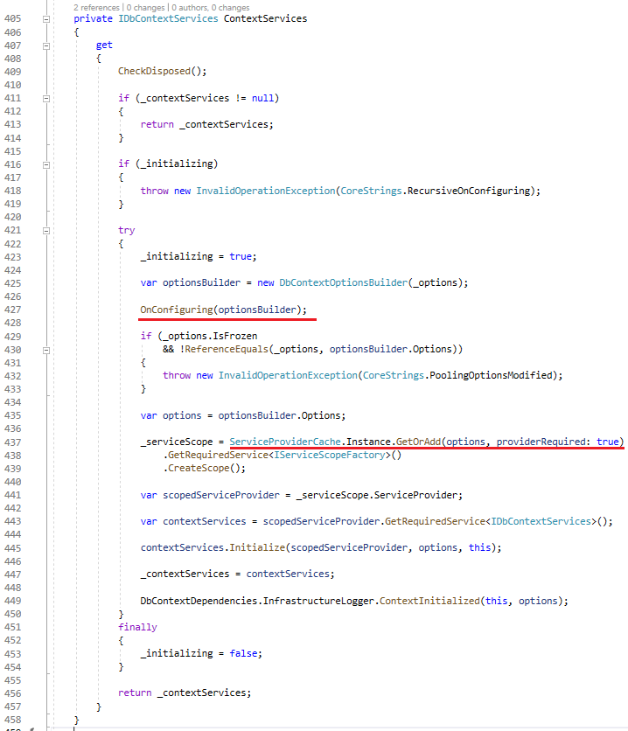
Service Provider Creation

Slide 21
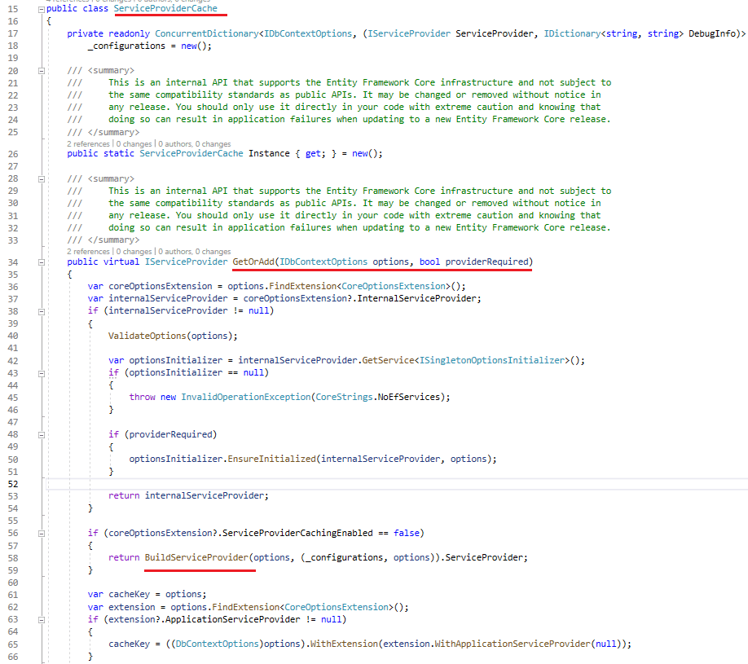
Service Provider Creation

Slide 22
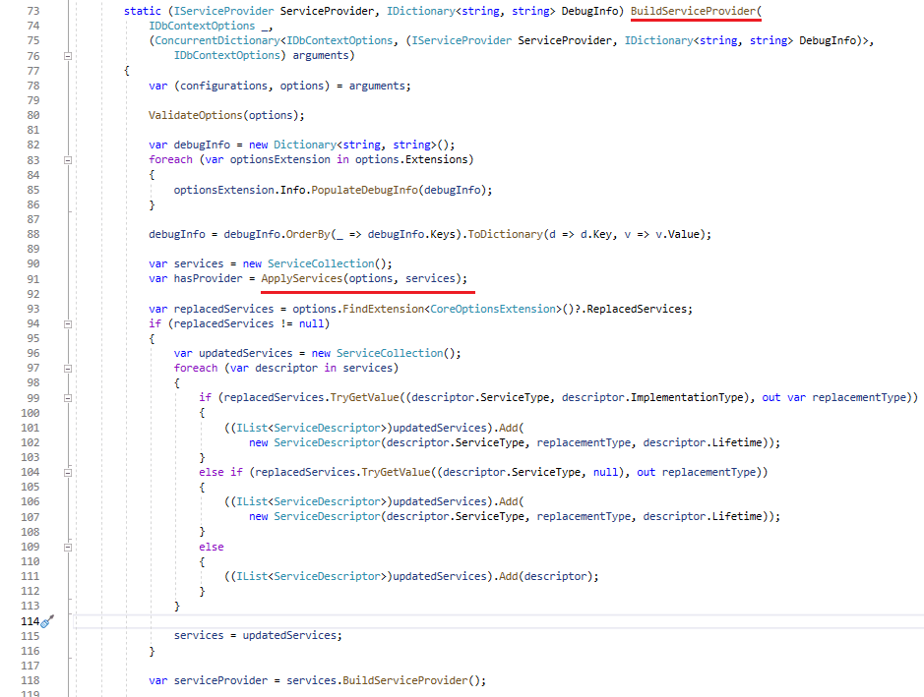
Service Provider Creation

Slide 23
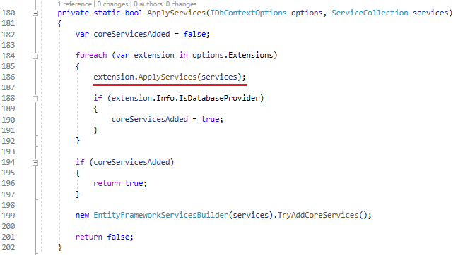
Service Provider Creation

Slide 24
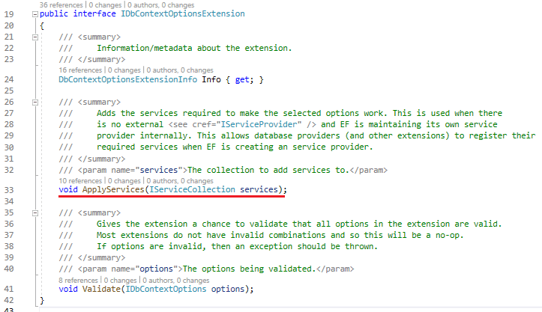
Service Provider Creation

Slide 25
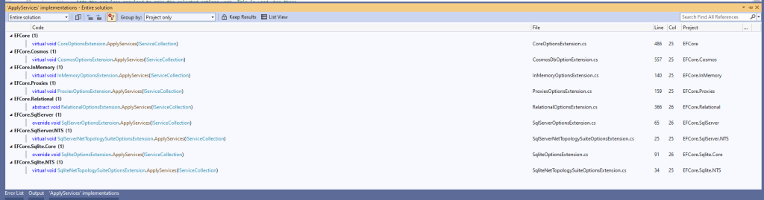
Service Provider Creation

Slide 26

Service Provider Creation

Slide 27
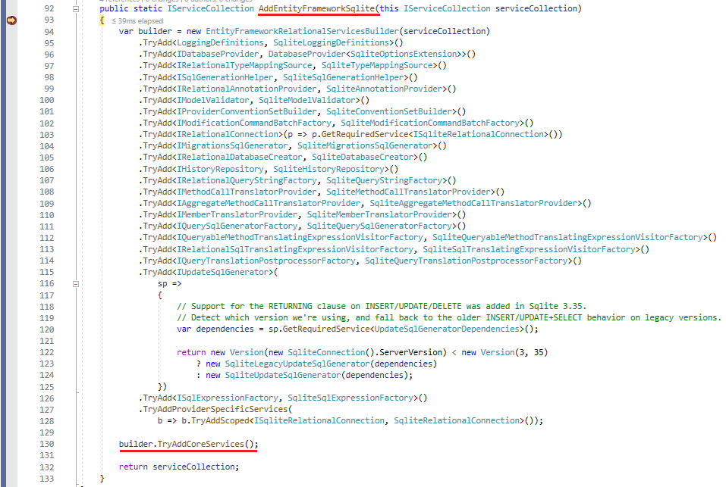
Service Provider Creation

Slide 28
Model Building

Slide 29
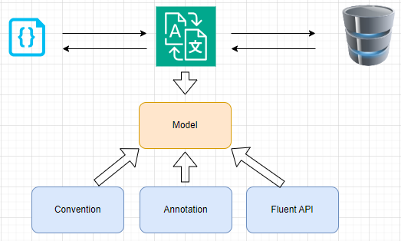
EF Core Model

Slide 30
Model Creation
https://blog.nashtechglobal.com/entity-framework-core-internals-model-building/

Slide 31
Query Pipelines

Slide 32
IEnumerable vs IQueryable

Slide 33
IEnumerable
An abstraction in .Net referring to something you can enumerate over.

Slide 34
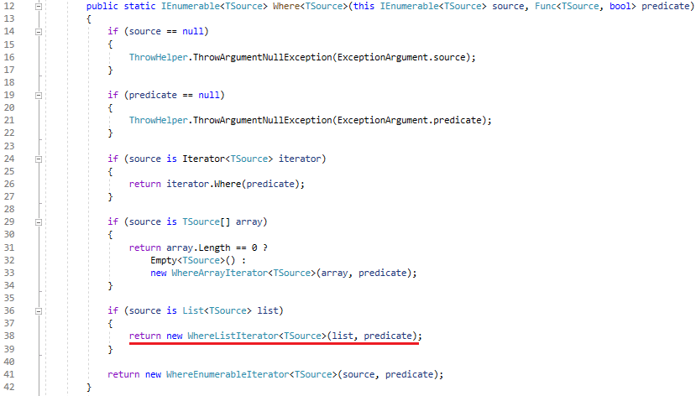
IEnumerable

Slide 35
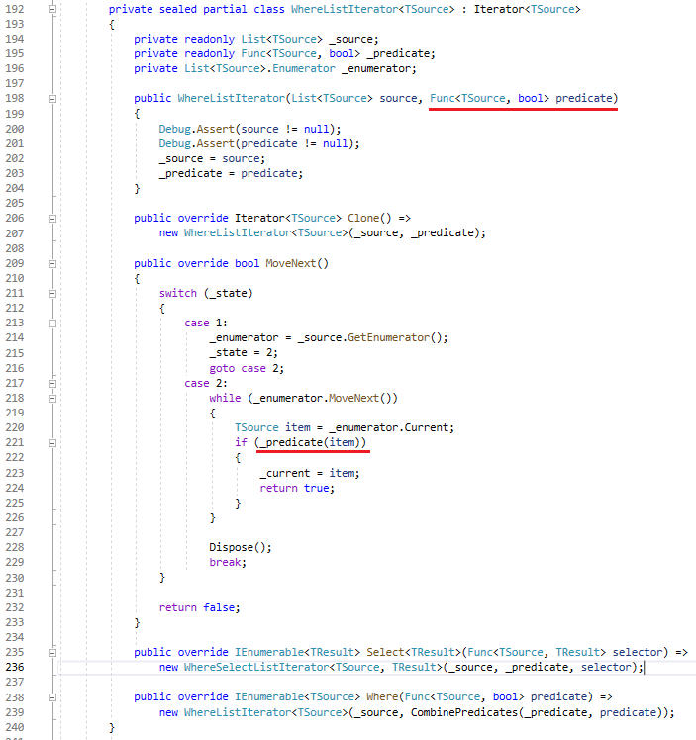
IEnumerable

Slide 36
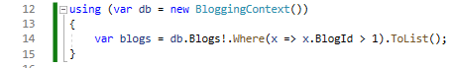
IQueryable
Something similar to IEnumerable, however, it’s not a stream of data that we can enumerate now, it’s basically an abstraction of something we can query over.

Slide 37
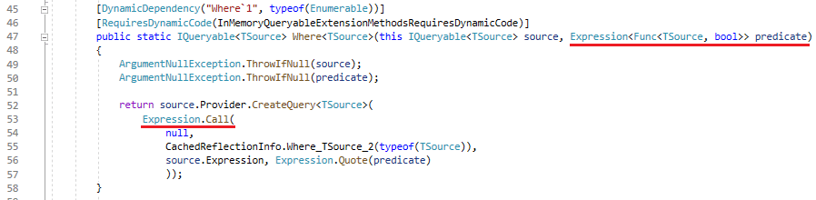
IQueryable

Slide 38
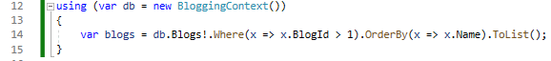
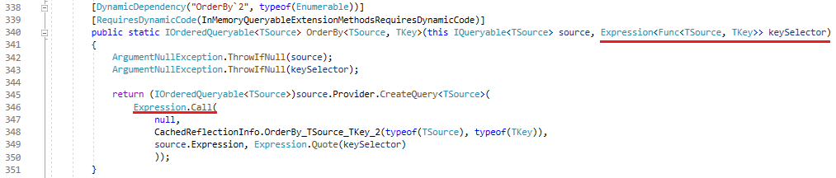
IQueryable

Slide 39
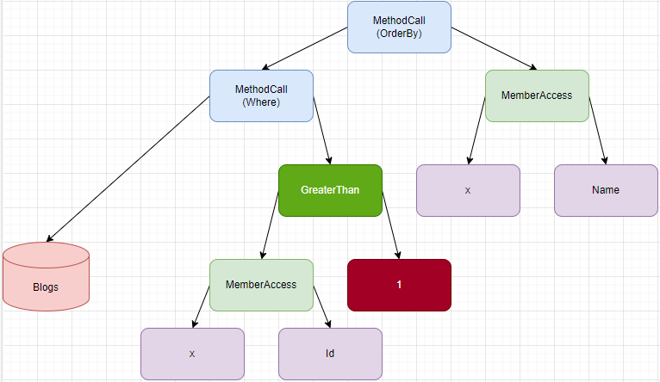
IQueryable

Slide 40
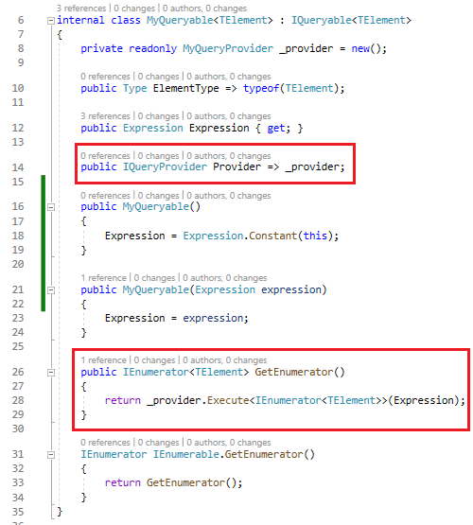
Query Providers

Slide 41
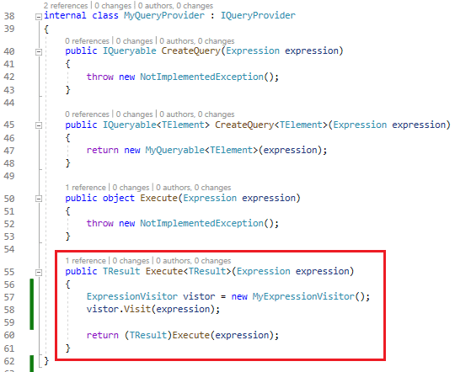
Query Providers

Slide 42
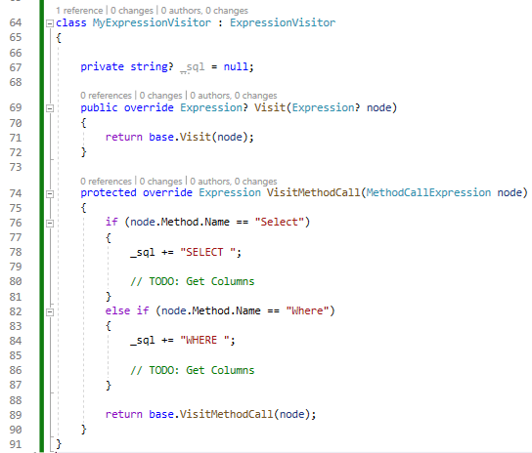
Query Providers

Slide 43
Demo

Slide 44
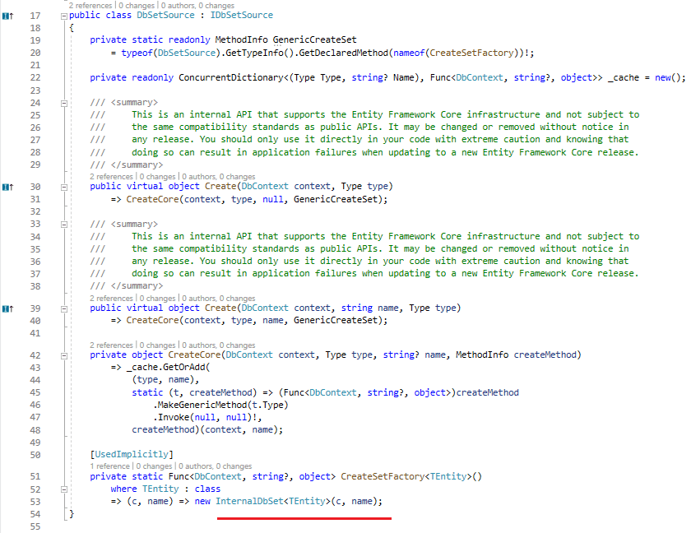
EF Core Query Provider

Slide 45
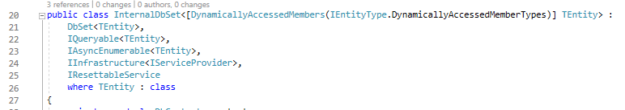
EF Core Query Provider

Slide 46
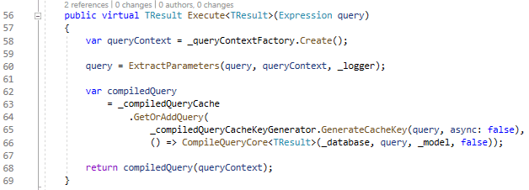
EF Core Query Provider

Slide 47
Query Pipelines

Slide 48
Query Provider
Responsible for handling the expression and return results, but it doesn’t do much, it just forwards the expression to the Query Compiler.

Slide 49
Query Compiler
Responsible for compiling the query tree, compiling the logic to invoke the Translator, and compiling the Materializer.

Slide 50
Translator
Responsible for traversing the expression tree and generating the instruction (ex: SQL script) that can be understood by the underlying database.

Slide 51
Materializer
Code generated at runtime to create optimized code for the user’s model.
Responsible for reading back the database results and materializing them. This is also a part of the query compilation.

Slide 52
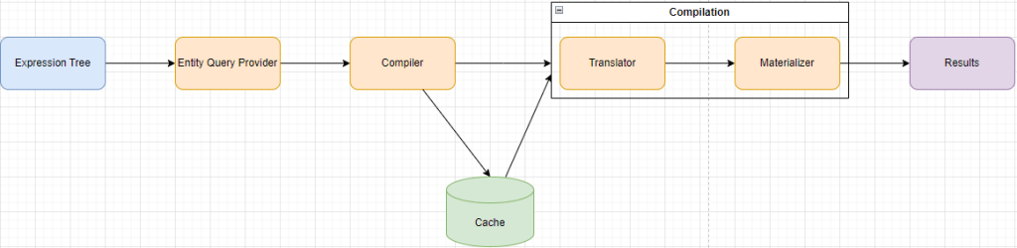
Caching

Slide 53
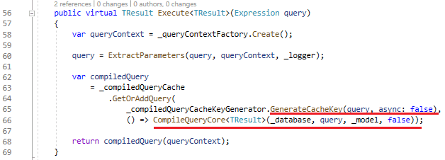
Caching

Slide 54
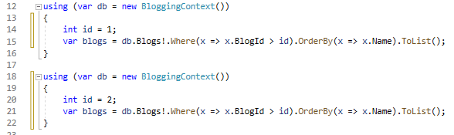
Caching Problem

Slide 55
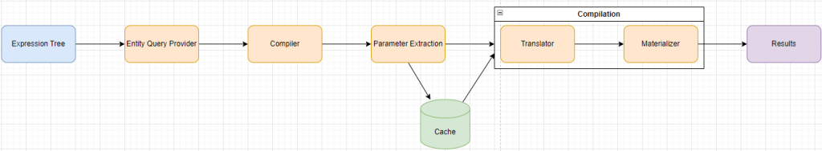
Caching Solution

Slide 56
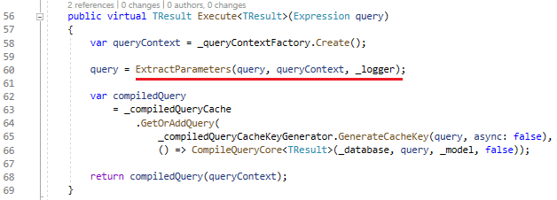
Parameters Extraction

Slide 57
Demo

Slide 58

Resources
EF Core Internals: High-Level Overview
EF Core Internals: DbContext Instantiation and Initialization
EF Core Internals: Dependency Injection and Internal Service Provider
EF Core Internals: Model Building
EF Core Internals: Query Pipelines

Slide 59
Thank you!

